Slide 1
LONGITUDINAL ACCELARATION AND BRAKING ANALYSIS OF BMW 220I M SPORT
By Aayush D Sharma(M22ME001)

Slide 2
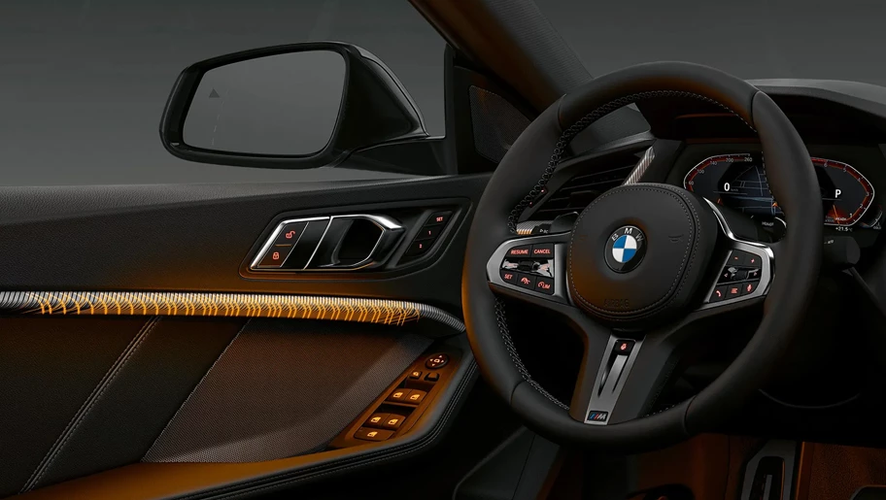
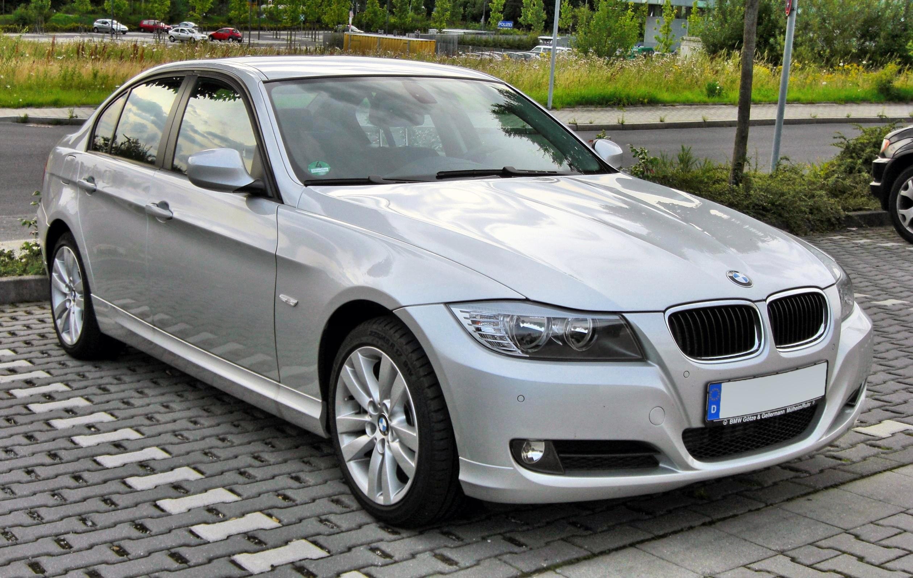




LONGITUDINAL ACCELERATION ANALYSIS
BMW 2 SERIES GRAN COUPE 220I M SPORT
KERB WEIGHT: 1505 kg
WHEELBASE: 2670 mm
MID-HEIGHT: 710 mm
MID-LENTH: 2263 mm
GROUND CLEARANCE:152 mm
TORQUE: 280 Nm (Petrol)/
400 Nm (Diesel)
POWER: 190hp
This Photo by Unknown Author is licensed under CC BY-SA

Slide 3




LONGITUDINAL ACCELERATION ANALYSIS
$${ma}_{x}{=−\left(\frac{W}{g}\right)∗D_{x}=−F_{xf} −F_{xr} −D_{A} −R−W\sin{θ}}$$
Low Speed Acceleration:
The weight distributed on Front axle and rear axle is given below
W = overall Weight($W_{f}+ W_{r})$
m = mass
$$a_{x} or D_{x}=acceleration or Deceleration$$
F = Traction force
R = Rolling Resistance
$$D_{A}=Drag Force$$
W $\sin{θ}=Uphill grade$
where grade = Rise/Run
L = Wheelbase
$W_{r}=W(\frac{b}{L}$ - $\frac{a_{x}h}{gL})$

Slide 4
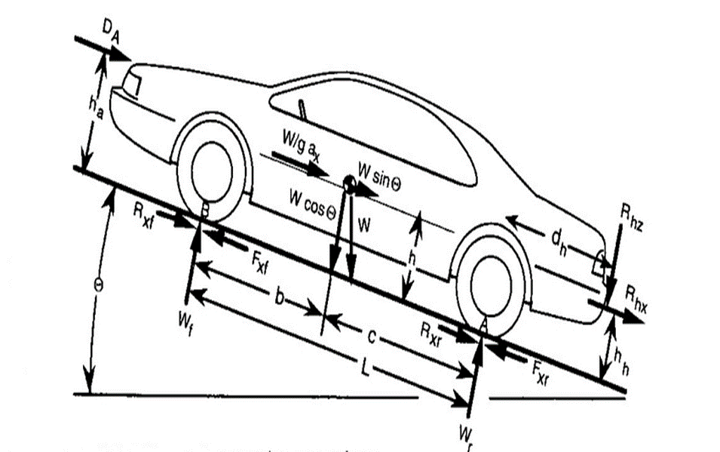

LONGITUDINAL ACCELERATION ANALYSIS
Neglecting the hinge force, for BMW 220i M Sport
L = 2670 mm
h = 462.5 mm
$$h_{a}=710 mm$$
W = 1505 kg
b = 1200 mm (from front axle)
c = 1470 mm

Slide 5
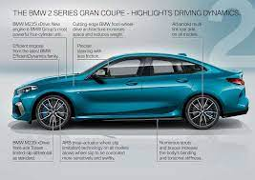

LONGITUDINAL ACCELERATION ANALYSIS
On BMW 220i M sport, the load distribution on front and rear axle is,
The car can go 0 to 27.78 m/s in 7.1 seconds ON HIGHWAYS
$$W_{f}=724.8 kg$$
$$W_{r}= 572.5 kg$$

Slide 6

TRACTIVE FORCE
The different traction coefficient is given below, based on the following chart, the tractive force has been calculated by
$$F_{x}=μ_{R}W$$
Tractive force is taken on one wheel two wheels , three wheels and four wheels .
SURFACE | Traction Coefficient
Wet Ice | 0.1
Dry Ice/Snow | 0.2
Loose Sand | 0.35
Dry Clay | 0.55
Wet rolled Gravel | 0.45
Dry rolled Gravel | 0.6
Wet Asphalt | 0.62
Wet Concrete | 0.63
Dry Asphalt | 0.9
Dry Concrete | 0.9

Slide 7
TRACTIVE FORCE

Slide 8

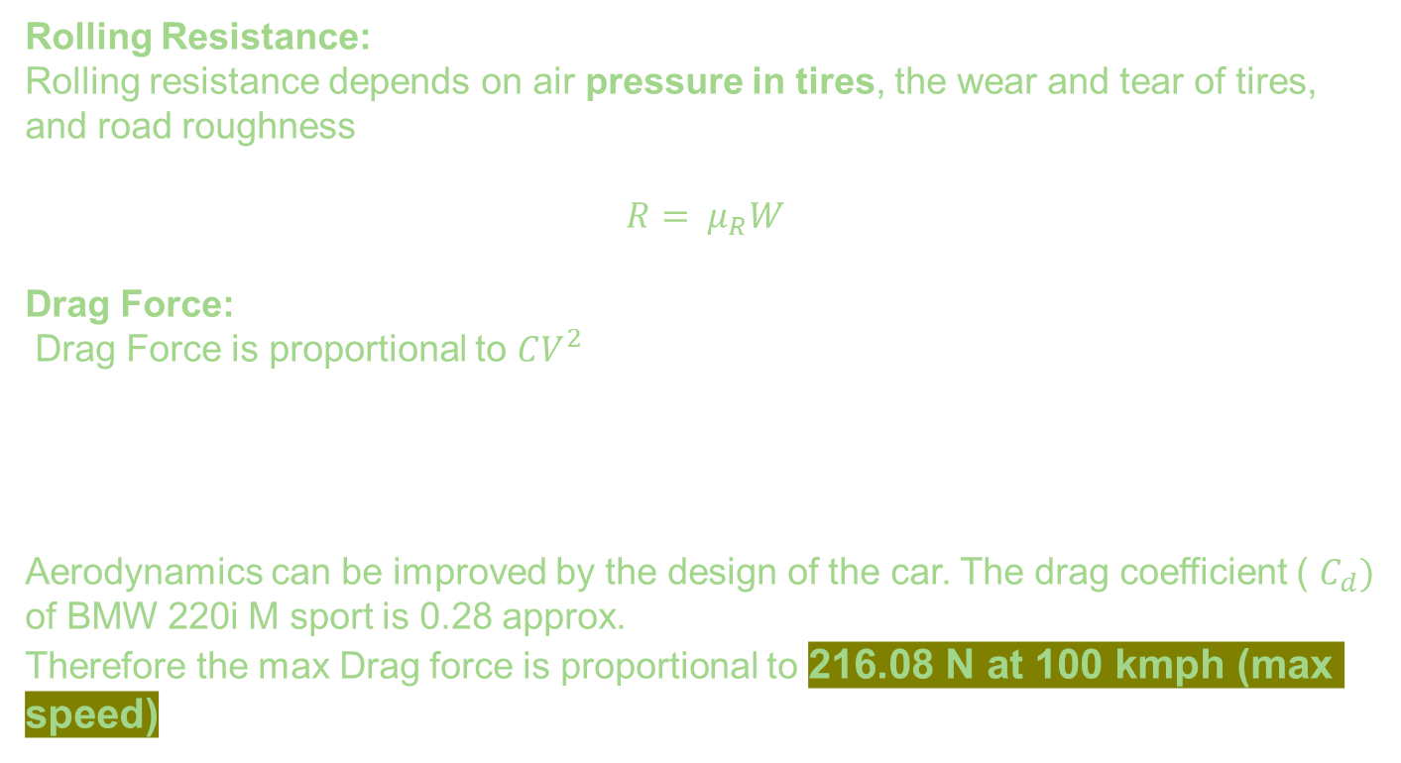

BRAKING ANALYSIS
Rolling Resistance:
Rolling resistance depends on air pressure in tires, the wear and tear of tires, and road roughness
$$R= μ_{R}W$$
Drag Force:
Drag Force is proportional to $CV^{2}$
Aerodynamics can be improved by the design of the car. The drag coefficient ( $C_{d})$ of BMW 220i M sport is 0.28 approx.
Therefore the max Drag force is proportional to 216.08 N at 100 kmph (max speed)
V : Velocity of vehicle
$$D_{A}=KCV^{2}$$

Slide 9

BRAKING ANALYSIS
ROLLING COEFFICIENT | ROLLING RESISTANCE
0.015 | 22.575
0.02 | 30.1
0.025 | 37.625
0.03 | 45.15
0.06 | 90.3
0.3 | 451.5

Slide 10

BRAKING ANALYSIS
Wind Resistance should also be taken account while calculating tractive force, $\sum{F_{x}}=F_{B}+CV^{2}$
Suppose at highway we apply brakes at 8880 N of braking force, then $\sum{F_{x}}=9096.$
The Drag factor would be low in city due to constructed buildings, so same braking force at same speed would be $\sum{F_{x}}=8957 approx.$

Slide 11


STOPPING DISTANCE
$$SD=\frac{M}{2C}\ln{\frac{F_{B}+CV^{2}}{F_{B}}}$$
Stopping Distance in Highway can be 26.78 meters and in city can be approximately 0.6 meters
Energy required to apply brakes is calculated by,
$$E=\frac{M}{2}(V_{f}^{2}−V^{2})$$
On highways and city, energy required would be both same i.e., 59037.2 J

Slide 12
VEHICLE ANALYSIS FOR TRACTION FORCE AND BRAKING FORCE AND TAKING VARIOUS FACTORS ARE GIVEN BELOW
VEHICLE PARAMETERS (BMW 220I M SPORT )
VEHICLE MASS (M) |  | VEHICLE WEIGHT (W) |  | WHEELBASE (L) |  | CG TO FRONT AXLE (B) |  | CG TO REAR AXLE (C) |  | CG HEIGHT (H)
lbs | Kg | ft.lb/s² | N | inches | mm | inches | mm | inches | mm | inches | mm
3380 | 1533 | 108748 | 15035 | 107.9 | 2741 | 47.2 | 1199 | 60.7 | 1542 | 18.2 | 462
Traction and Acceleration Analysis @ (50:50 Torque Distribution) |  |  |  |  |  |  |  | μ_{s} = | 0.9 | & μ_{f} = | 0.7
Grade (θ) |  | Acceleration (mps)
 |  | 0.000 |  | 1.875 |  | 3.750 |  | 5.625 |  | 7.500
deg. | % | W_{f} (N) | W_{r} (N) | W_{f} (N) | W_{r} (N) | W_{f} (N) | W_{r} (N) | W_{f} (N) | W_{r} (N) | W_{f} (N) | W_{r} (N)
 |  | F_{xf} (N) | F_{xr} (N) | F_{xf} (N) | F_{xr} (N) | F_{xf} (N) | F_{xr} (N) | F_{xf} (N) | F_{xr} (N) | F_{xf} (N) | F_{xr} (N)
 |  | Weight Transfer % |  | Weight Transfer % |  | Weight Transfer % |  | Weight Transfer % |  | Weight Transfer %
0.0 | 0.0 | 8458.1 | 6576.9 | 7973.2 | 7061.7 | 7488.3 | 7546.4 | 7003.4 | 8031.1 | 6518.5 | 8515.8
 |  | 0.0 | 0.0 | 1437.3 | 1437.3 | 2874.6 | 2874.6 | 4312.0 | 4312.0 | 5749.3 | 5749.3
 |  | 0.0% |  | 3.2% |  | 6.4% |  | 9.7% |  | 12.9%
2.5 | 4.4 | 8339.4 | 6681.3 | 7854.5 | 7166.0 | 7369.6 | 7650.7 | 6884.7 | 8135.4 | 6399.9 | 8620.2
 |  | 327.9 | 327.9 | 1765.2 | 1765.2 | 3202.5 | 3202.5 | 4639.9 | 4639.9 | (SLIP) 4479.9 | 6077.2
 |  | 0.7% |  | 4.0% |  | 7.2% |  | 10.4% |  | 13.6%

Slide 13
BRAKE PARAMETERS
INITIAL SPEED (U) |  | FINAL SPEED (V) |  | STOPPING DISTANCE (S) |  | DECELERATION (-A_{X}) |  | TIME TAKEN (T) | BRAKE FORCE (F_{B}) | COEFFICIENT OF DRAG (CD)
mph | mps | mph | mps | ft | m | ft/s² | m/s² | s | N
60 | 26.82 | 0 | 0.00 | 108.4 | 33.04 | 35.7 | 10.89 | 2.46 | 16692 | 0.23
BRAKE ANALYSIS TAKING AERODYNAMIC DRAG INTO CONSIDERATION
INITIAL SPEED (U) | FINAL SPEED (V) | DIFFERENCE (U-V) | BRAKE FORCE (F_{B}) | DRAG FORCE (F_{D}) | STOPPING DISTANCE (S) |  | TIME TAKEN (T) | ENERGY DISSIPATED (E) |  | BRAKE POWER (P)
mps | mps | mps | N | N | ft | m | s | ft.lb | KWh | ft.lb/s | hp
69.29 | 0.00 | 69.29 | 16692 | 546 | 700.5 | 213.50 | 6.16 | 2621136.12 | 0.987 | 425328.58 | 775.495
50.00 | 0.00 | 50.00 | 16692 | 286 | 370.3 | 112.88 | 4.52 | 1385791.48 | 0.522 | 306919.17 | 559.601
26.82 | 0.00 | 26.82 | 16692 | 83 | 107.8 | 32.87 | 2.45 | 403559.05 | 0.152 | 164631.44 | 300.170
50.00 | 40.00 | 10.00 | 16692 | 471 | 131.9 | 40.20 | 0.89 | 493495.42 | 0.186 | 552454.50 | 1007.282
BRAKE ANALYSIS TAKING GRADE INTO CONSIDERATION
GRADE (Θ) | INITIAL SPEED (U) | FINAL SPEED (V) | BRAKE FORCE (F_{B}) | DRAG FORCE (F_{D}) | STOPPING DISTANCE (S) |  | TIME TAKEN (T) | ENERGY DISSIPATED (E) |  | BRAKE POWER (P)
deg. | mps | mps | N | N | ft | m | s | ft.lb | KWh | ft.lb/s | hp
20 | 69.29 | 0.00 | 16692 | 548 | 539.5 | 164.44 | 4.75 | 2018761.46 | 0.760 | 425328.58 | 775.495
 | 50.00 | 0.00 | 16692 | 286 | 284.2 | 86.64 | 3.47 | 1063615.45 | 0.401 | 306919.17 | 559.601
 | 26.82 | 0.00 | 16692 | 83 | 82.5 | 25.16 | 1.88 | 308872.16 | 0.116 | 164631.44 | 300.170
-5 | 69.29 | 0.00 | 16692 | 546 | 758.1 | 231.08 | 6.67 | 2836866.48 | 1.068 | 425328.58 | 775.495
 | 50.00 | 0.00 | 16692 | 286 | 401.3 | 122.32 | 4.89 | 1501709.80 | 0.566 | 306919.17 | 559.601
 | 26.82 | 0.00 | 16692 | 83 | 117.0 | 35.66 | 2.66 | 437756.11 | 0.165 | 164631.44 | 300.170
-10 | 69.29 | 0.00 | 16692 | 545 | 825.6 | 251.63 | 7.26 | 3089202.26 | 1.163 | 425328.58 | 775.495
 | 50.00 | 0.00 | 16692 | 286 | 437.6 | 133.39 | 5.34 | 1637656.02 | 0.617 | 306919.17 | 559.601
 | 26.82 | 0.00 | 16692 | 83 | 127.7 | 38.93 | 2.90 | 477948.68 | 0.180 | 164631.44 | 300.170

Slide 14
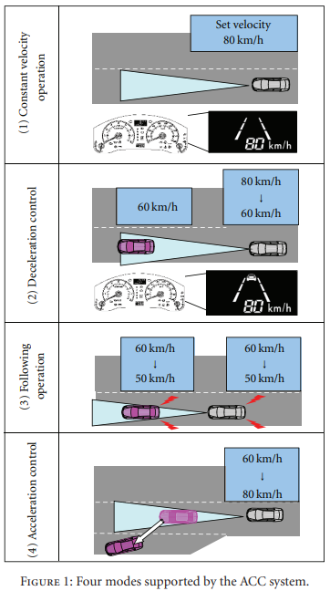
CRUISE CONTROL
Constant velocity control: when there are no vehicles straight ahead, or when there is a large distance between the driver’s vehicle and the preceding vehicle, the system maintains a constant vehicle velocity.
Deceleration control: when a vehicle traveling ahead at a slower speed is detected, the system uses the throttle to decelerate the driver’s vehicle. If this deceleration is insufficient, the system uses the brake to decelerate the vehicle.
Following control: when the driver’s vehicle is following behind the preceding vehicle, the system controls the throttle and brake so that the time interval between the vehicles (which corresponds to a distance between the vehicles that is proportional to the velocity of the driver’s vehicle) is the time which was set by the driver.
Acceleration control: when, due to a lane change, there is no longer a vehicle ahead of the driver’s vehicle, the system accelerates the vehicle up to the velocity set by the driver, and then maintains a constant velocity. Furthermore, when the driver’s vehicle approaches a vehicle ahead of it without slowing down enough, an alert buzzer and display prompt the driver to apply the brakes or take other appropriate action.

Slide 15
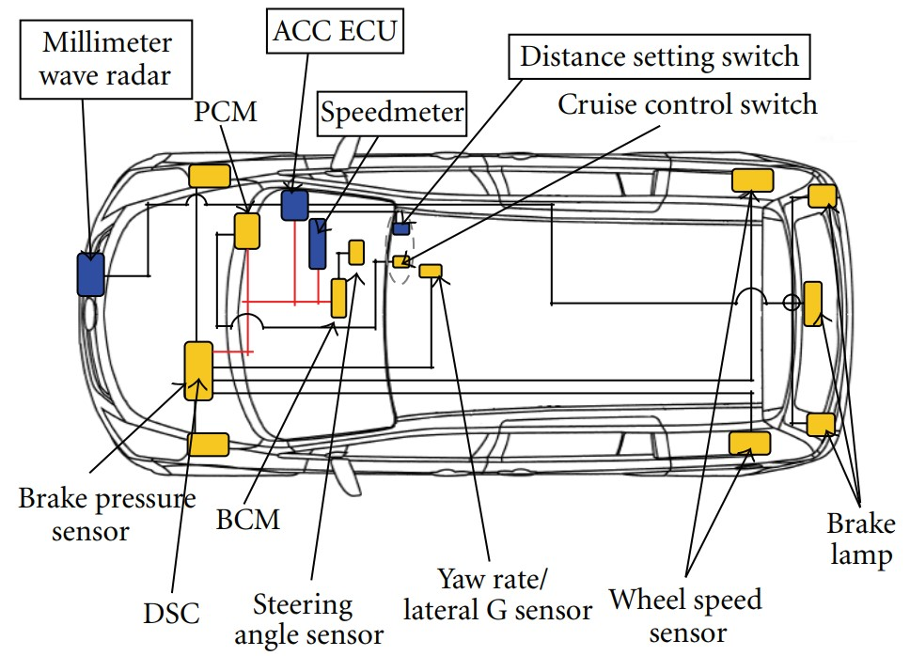
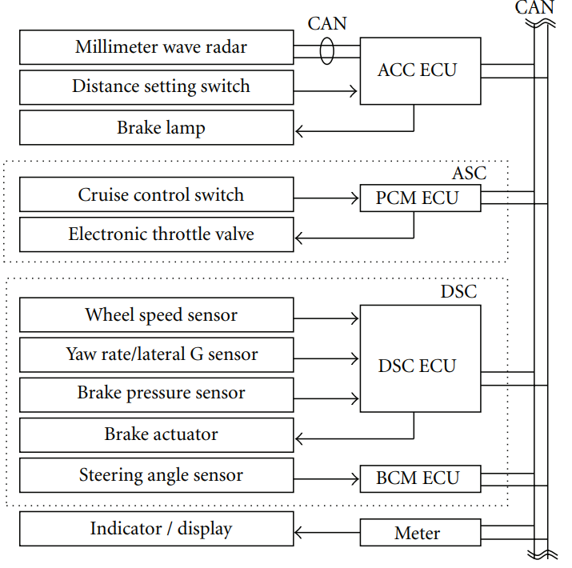
LAYOUT AND SYSTEM CONFIGURATION

Slide 16
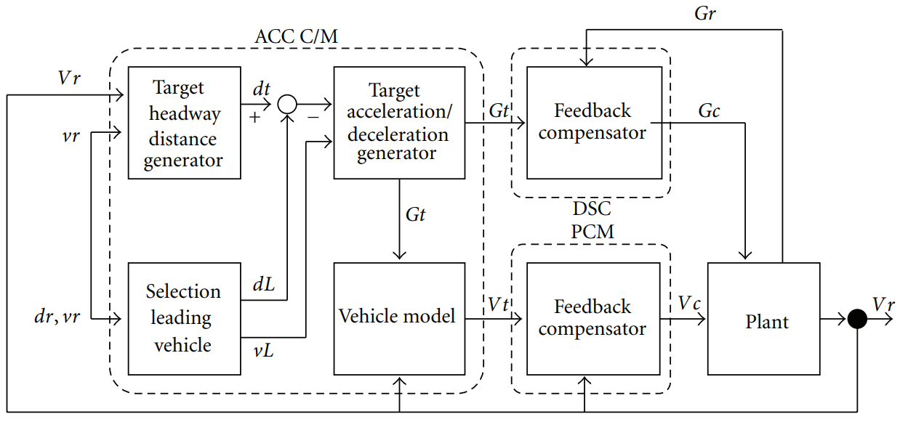
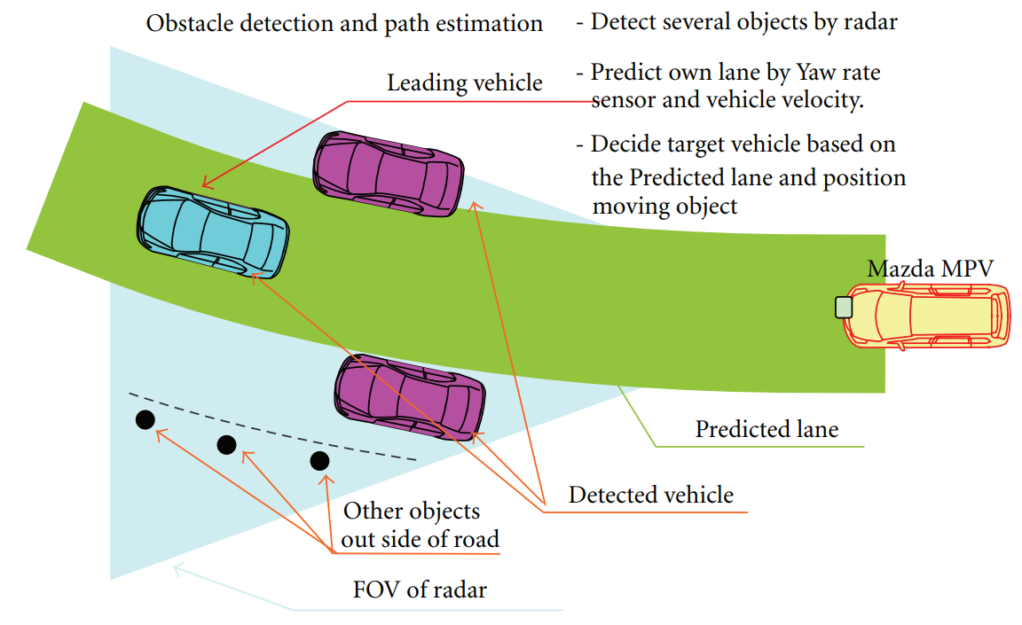
CONTROL BLOCK DIAGRAM AND DETECTION OF PRECIDING VEHICLE

Slide 17
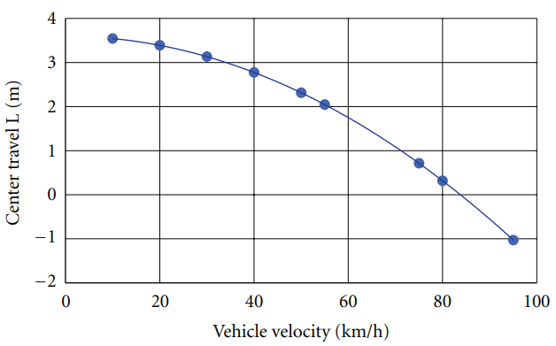
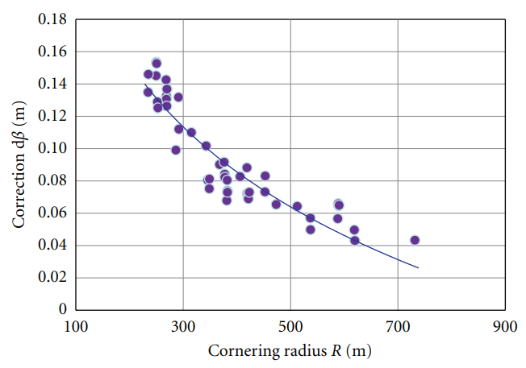
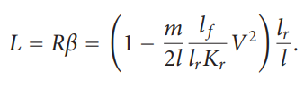
RELATIONSHIP BETWEEN AMOUNT OF CENTER TRAVEL L AND THE VEHICLE VELOCITY
RELATION BETWEEN AMOUNT OF CORRECTION AND CORNERING RADIUS

Slide 18
CONCLUSION
Improving the preceding vehicle lock-on performance by improving the Millimeter Wave Radar unit and making full use of object identification logic and path estimation logic resulted in improved driving stability. This performance was achieved even on an expressway with continuous sharp turns in a mountainous region, or an expressway with multiple lanes and heavy traffic in an urban area. The preceding vehicle identification performance was approximately the same as or better than the performance of other such systems in the industry.
For the acceleration/deceleration performance, which has a large effect on occupant comfort, when the lane was changed during tracking and the preceding vehicle sped up, the acceleration performance satisfied the need for a smooth feeling of acceleration with a short response delay.
Conversely, when the driver’s vehicle caught up with the preceding vehicle, a smooth and comfortable feeling of deceleration was achieved.

